Slide 1

Computational Problem Solving
Two things that are needed to perform computational problem solving:
a representation that captures all the relevant aspects of the problem
an algorithm that solves the problem by use of the representation
Thus, computational problem solving finds a solution within a representation that translates into a solution for what is being represented.

Slide 2
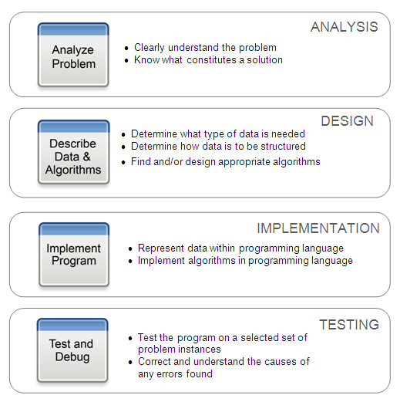
Computational Problem Solving Steps

Slide 3

Man, Cabbage, Goat, Wolf Problem
A man lives on the east side of a river. He wishes
to bring a cabbage, a goat, and a wolf to a village on the west side of the river to sell. However, his boat is only big enough to hold himself, and either the cabbage, goat, or wolf. In addition,
the man cannot leave the goat alone with the cabbage because the goat will eat the cabbage, and he cannot leave the wolf alone with the goat because the wolf will eat the goat. How does the man solve his problem?

Slide 4
There is a simple algorithmic approach for solving this problem by simply trying all possible combinations of items that may be rowed back and forth across the river.
Trying all possible solutions is referred to as a brute force approach.
What would be an appropriate representation for this problem? Whatever representation we use, only the aspects of the problem that are relevant for its solution need to be represented.
Color of the boat?
Name of the man?
Width of the river?
The only information relevant for this problem is where each particular item is at each step in the problem solving. Therefore, by the use of abstraction, we define a representation that captures only this needed information.

Slide 5
For example, we could use a sequence to indicate where each of the objects currently are,
man cabbage goat wolf boat village
[east, west, east, west, east, west]
where it is understood that the first item in the sequence is the location of the man, the second the location of the cabbage, etc.
Note that the village is always on the west side of the river—it doesn’t move! Its location is fixed and therefore does not need to be represented.
Also, the boat is always in the same place as the man. So representing the location of both the man and the boat is redundant information. The relevant, minimal representation is given below,
man cabbage goat wolf
[E, W, E, E]

Slide 6
The actual problem is to determine how the man can put objects across the river, with certain constraints on which pairs of objects cannot be left alone.
The computational problem is to find a way to convert the representation of the start state of the problem, when all the object are on the east side of the river,
man cabbage goat wolf
[E, E, E, E]
to the goal state with all objects on the west side of the river,
man cabbage goat wolf
[W, W, W, W
with the constraint that certain invalid states should never be used.
Thus, in a computational problem solving approach, a problem is solved within the representation used, in which the solution within the representation must translate into a solution of the actual problem.

Slide 7
For example, from the start state, there are three possible moves that can be made, only one of which results in a valid state.
man cabbage goat wolf
[E, E, E, E] START STATE
[W, W, E, E]
[W, E, W, E]
[W, E, E, W]
Man rows cabbage across
Man rows goat across
Man rows wolf across
INVALID STATE
Goat left alone with wolf
VALID STATE
Cabbage left alone with wolf
INVALID STATE
Cabbage left alone with goat

Slide 8
We check if the new problem state is the goal state. If true, then we solved the problem in one step! (We know that cannot be so, but the algorithmic approach that we are using does not.)
man cabbage goat wolf
[E, E, E, E] START STATE
[W, E, W, E]
Man rows goat across
Is goal state [W,W,W,W]?
No
Therefore we continue searching from the current state.

Slide 9
Since the man can only row across objects on the same side of the river, there are only two possible moves from here,
man cabbage goat wolf INTERMEDIATE
[W, E, W, E] STATE
[E, W, E, E]
[E, E, E, E]
Man rows back alone
Man rows goat across
VALID STATE
Cabbage left alone with wolf
VALID STATE
BUT, previously in this state. It is the start state. No progress made!

Slide 10
This would continue until the goal state is reached,
man cabbage goat wolf
[E, W, E, E]
[W, W, W, W] GOAL STATE
Thus, the computational problem of generating the goal state from the start state translates into a solution of the actual problem since each transition between states has a corresponding action in the actual problem—of the man rowing across the river with (or without) a particular object.
.
.
Brute force method

Slide 11
man cabbage goat wolf
[E, W, E, E]
[W, E, W, E] M^
[W, W, W, E] MVC
[E, W, E, E] M^G
[W, W, E, W] M^
[W, W, W, W] GOAL STATE

Slide 12
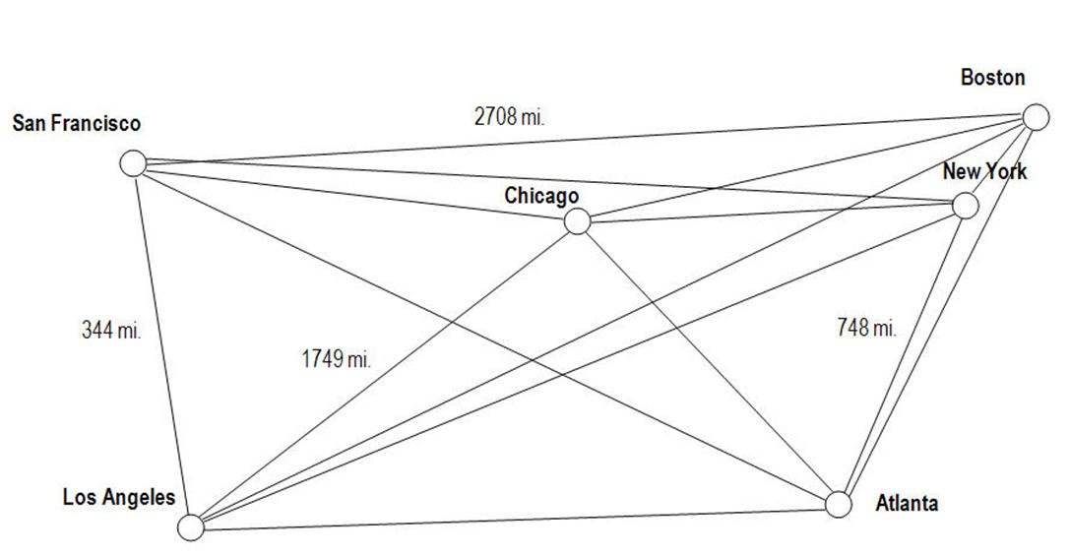
The Traveling Salesman Problem
A salesman needs to visit a set of cities. He wants to find the shortest route of travel, starting and ending at any city for a given set of cities, what route should he take?
The algorithm for solving this problem is a simple one. Determine the lengths of all possible routes that can be taken, and find the shortest one. That is, by using a brute force approach. The computational issue, therefore, is for a given set of cities, how many possible routes are there?

Slide 13
If we consider a route to be a specific sequence of names of cities, then how many permutations of that list are there?
New York, Boston, Chicago, San Francisco, Los Angeles, Atlanta
New York, Boston, Chicago, San Francisco, Atlanta, Loa Angeles
New York, Boston, Chicago, Los Angeles, San Francisco, Atlanta
etc.
Mathematically, the number of permutations for n entities is n! (n factorial).
How big a number is that for various number of cities?

Slide 14
Below are the number of permutations (and this number of routes) there are for varies numbers of cities:
Ten Cities 10! 3,628, 800 (over three million)
Twenty Cities 20! 2,432,902,008,176,640,000
Fifty Cities 50! Over 10⁶⁴
If we assume that a computer could compute the routes of one million cities per second:
for twenty cities, it would take 77,000 years
for fifty cities, it would take longer than the age of the universe!

Slide 15
GCD of two numbers
x=10
y=20
if x > y:
small = y
else:
small = x
for i in range(1, small+1):
if((x % i == 0) and (y % i == 0)):
gcd = i
print(gcd)

Slide 16
Euclid’s Algorithm One of the Oldest Known Algorithms
An algorithm for computing the greatest common denominator (GCD) of two given integers. It is one of the oldest numerical algorithms still in common use.
1. Assign A the value of the larger of the two values.
2. Divide A by B, call the remainder R.
3. If R is not 0, then assign A the value of B, assign B the value of R, and go to step 2.
4. The greatest common divisor is B.

Slide 17
Example Use
Finding the GCD of 18 and 20
1. Assign A the value of the larger of the two values, and B the smaller. A ← 20 B ← 18

Slide 18
Example Use
Finding the GCD of 18 and 20
1. Assign A the value of the larger of the two values, and B the smaller. A ← 20 B ← 18
2. Divide A by B, call the remainder R.
M/N = 20 / 18 = 1, with R ← 2

Slide 19
Example Use
Finding the GCD of 18 and 20 (first time through, second time through)
1. Assign A the value of the larger of the two values, and B the smaller. A ← 20 B ← 18
2. Divide A by B, call the remainder R.
A/B = 20 / 18 = 1, with R ← 2
M/N = 18 / 2 = 9, with R ← 0
3. If R is not 0, assign A the value of B, assign B the value of R, and go to step 2.
R = 2. Therefore, A ← 18, B ← 2. Go to step 2.

Slide 20
Example Use
Finding the GCD of 18 and 20 (first time through, second time through)
1. Assign A the value of the larger of the two values, and B the smaller. A ← 20 B ← 18
2. Divide A by B, call the remainder R.
A/B = 20 / 18 = 1, with R ← 2
M/N = 18 / 2 = 9, with R ← 0
3. If R is not 0, assign A the value of B, assign B the value of R, and go to step 2.
R = 2. Therefore, A ← 18, B ← 2. Go to step 2.
R is 0. Therefore, proceed to step 4.

Slide 21
Example Use
Finding the GCD of 18 and 20
1. Assign A the value of the larger of the two values, and B the smaller. A ← 20 B ← 18
2. Divide A by B, call the remainder R.
A/B = 20 / 18 = 1, with R ← 2
M/N = 18 / 2 = 9, with R ← 0
3. If R is not 0, assign A the value of B, assign B the value of R, and go to step 2.
R = 2. Therefore, A ← 18, B ← 2. Go to step 2.
R is 0. Therefore, proceed to step 4.
4. The greatest common divisor is B.
GCD = B = 2

Slide 22
GCD of two numbers
a=20
b=10
while(b):
r=a%b
if(r==0):
print(b)
break
else:
a=b
b=r
a=20
b=10
while(b):
r=a%b
a=b
b=r
print(a)

Slide 23
find all factors of a given number
Input 10
Output 1 2 5 10
# find all factors of a given number
n = int(input("enter a number : "))
for i in range(1, n + 1):
if n % i == 0 :
print(i, end = " ")
print()

Slide 24
Pgm to print Fibonacci series up to n
f s t
0 1 1 2 3 5 8 13
f s t

Slide 25
Pgm to print Fibonacci series up to n
n=100
first=0
second=1
third=1
print(first,second,end=" ")
while(third<=n):
print(third,end=" ")
third=first+second
first=second
second=third
Use while wherever we have to

Slide 26
GCD of two numbers
x=10
y=20
if x > y:
small = y
else:
small = x
for i in range(1, small+1):
if((x % i == 0) and (y % i == 0)):
gcd = i
print(gcd)

Slide 27
Types of errors
Errors
Syntax error
Linker error
Logical error
Runtime error

Slide 28
Syntax error :-
print(“hello)
how to remove
By compiling
Logical error :-
zero errors,it takes Input but gives wrong output.
avg=a+b+c/3; // error in Logic
how to remove :
By debugging and tracing vaues

Slide 29
Runtime error
zero errors, zero warnings, takes input but no output
because error happens at run time
Example:
a=int(input("enter the value of a"))
b=int(input("enter the value of b"))
res=a/b
print(res)
How to remove?
By debugging and Exception handling.

Slide 30
Mixed-Type Expressions
A mixed-type expression is an expression containing operands of different type. The CPU can only perform operations on values with the same internal representation scheme, and thus only on operands of the same type. Operands of mixed-type expressions therefore must be converted to a common type. Values can be converted in one of two ways—by implicit (automatic) conversion, called coercion, or by explicit type conversion.
Type casting :
Process of changing the cast of variable or data is called type casting.

Slide 31
Coercion is the implicit (automatic) conversion of operands to a common type. Coercion is automatically performed on mixed-type expressions only if the operands can be safely converted, that is, if no loss of information will result.
The conversion of integer 2 to floating-point 2.0 below is a safe conversion—the conversion of 4.5 to integer 4 is not, since the decimal digit would be lost,
2 + 4.5 ➝ 2.0 + 4.5 ➝ 6.5 safe (automatic conversion of int to float)
int
float
float
float
float
implicit

Slide 32
Type conversion is the explicit conversion of operands to a specific type. Type conversion can be applied even if loss of information results. Python provides built-in type conversion functions int() and float(), with the int() function truncating results
2 + 4.5 ➝ float(2) + 4.5 ➝ 2.0 + 4.5 ➝ 6.5 No loss of information
2 + 4.5 ➝ 2 + int(4.5) ➝ 2 + 4 ➝ 6 Loss of information
int
float
float
float
float
float
float
int
float
int
int
int
int
int
explicit

Slide 33
print(“4”+5) ??
Print(int(“4”)+5)??
Print(“4”+str(5))
Explicit
type
casting

Slide 34
Type conversion
a="100"
print(int(a))
a="Bangalore 100"
print(int(a))
a=[10,20,30]
a=a[0]
print(int(a))
a=[10]
print(int(a))
a=[10,20,30]
print(int(a))
a=["10","20","30"]
print(int(a[0]))
a=3.14
print(int(a))
a="3.142222222222"
print(int(a))
a="Bangalore"
print(list(a))
a="100"
print(list(a))

Slide 35
int(x=0) -> integer
int(x, base=10) -> integer
x = int('101',2)
print(x) # x will be 5
x = int('F',16)
print(x) # x will be 15

Slide 36
What is the output of below code?
sep = "sep"
print(3,5,8,sep = sep, end = sep)
print(sep)

Slide 37
What is the output of below code. num=23 if ++num: print(num) num=num+1
24 printed infinitely
23 printed infinitely
23
Error
24

Slide 38
a=[1,2,3]
b=[4,5]
b=a
print(b)
A = [10,22,10,56,-21,-22,100]
print(A[-6:-3])

Slide 39
What is the output of below code A = [10,22,10,56,-21,-22,100] A[-6:-3] = [20] print(A) A) Error B) [10, 20, -21, -22, 100] C) [20] D) None of these

Slide 40
What is the output of below code? sep = 2 print(2>1<=9!=3) A)False B) Error C) True D) 0 E) 1
print("all the best "*3)

Slide 41
print("all the best "*3)

